Slide 1

Minnesota Interstate Traffic Volume
An in-depth analysis of traffic patterns on our interstate highways

Slide 2

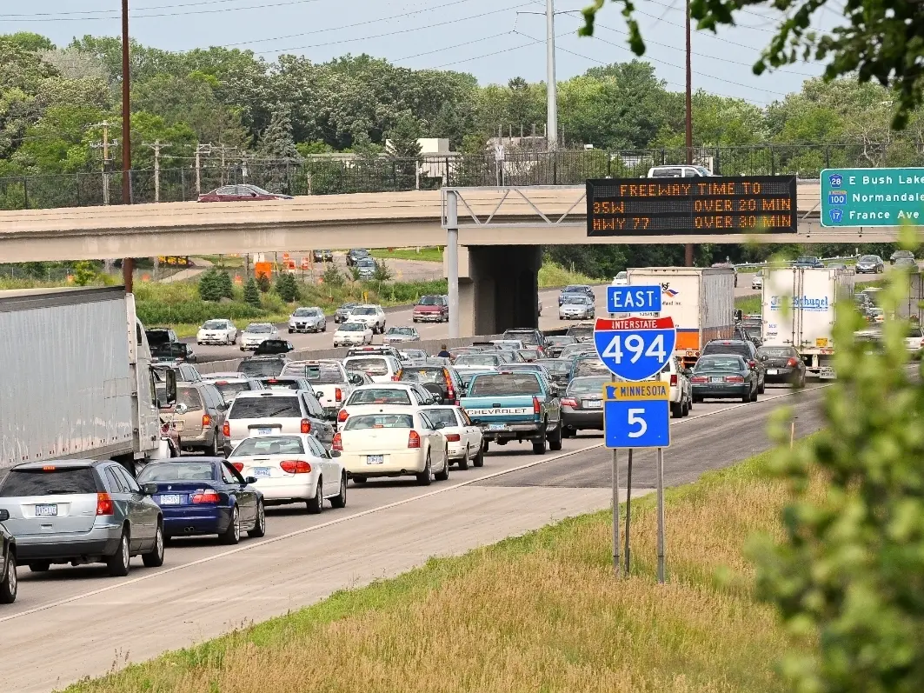
Traffic congestion continues to grow
… with no end in sight

Slide 3

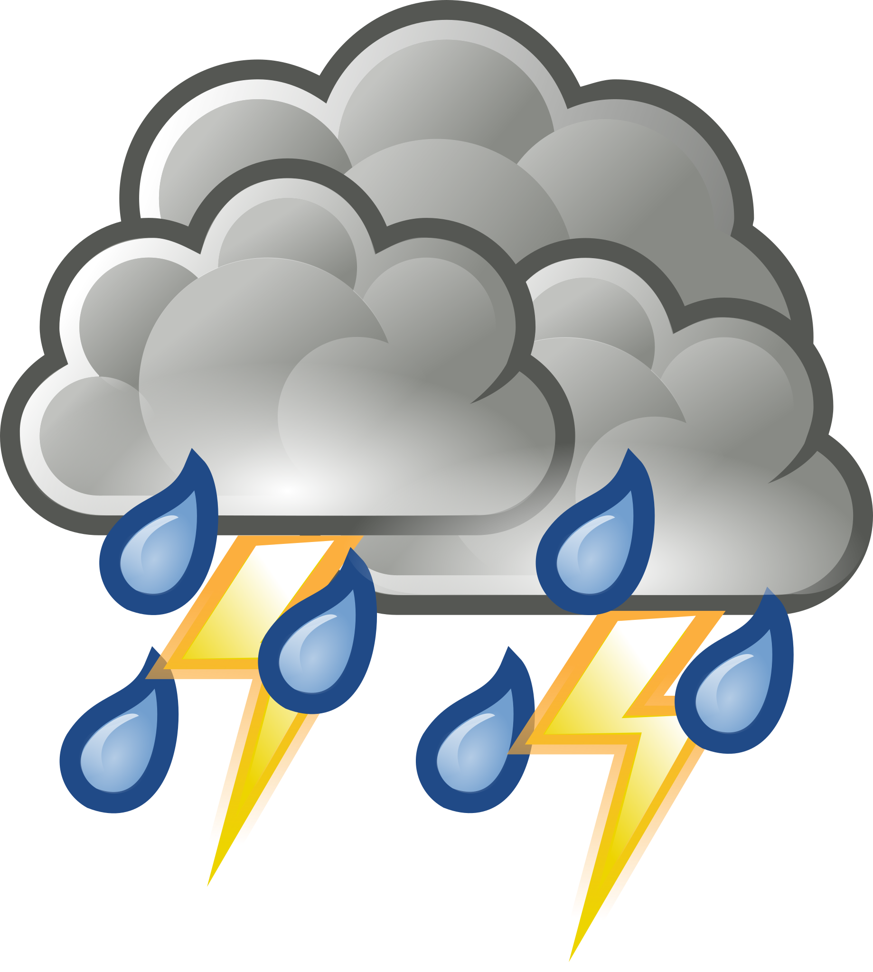
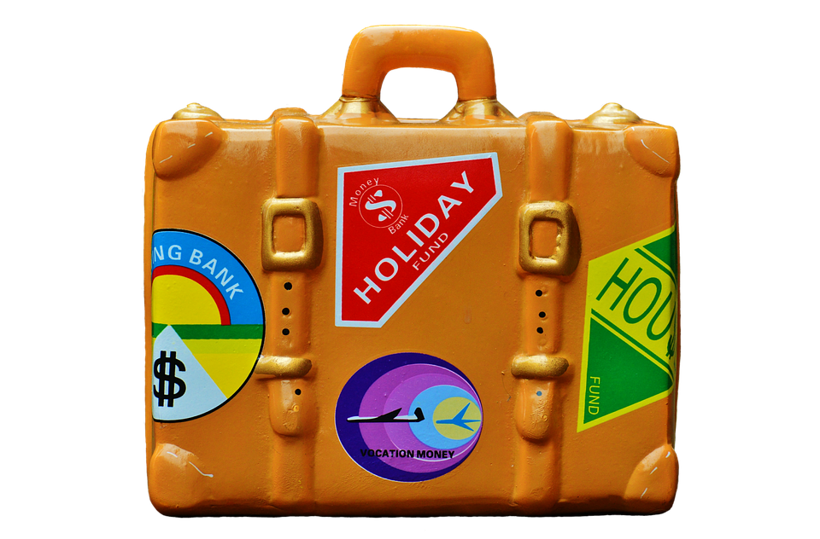
Analyzing the data in 3 distinct charts
Monthly Volumes
Viewing the monthly traffic patterns allows to find any potential trends by month
Weather
Weather can have an impact on many things, including traffic
Holiday Travel
Our roads may see more travelers (including out of state) than expected

Slide 4
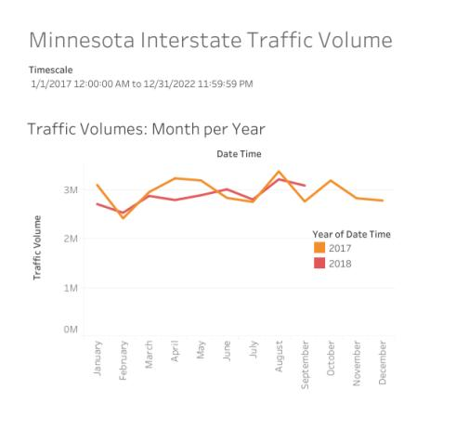
Monthly traffic volumes
August - Highest volume, possible end of summer seasonal traffic
February - Lowest volume, best possible month for construction changes
April - Significant decrease in 2018
Fairly consistent/predictable patterns

Slide 5
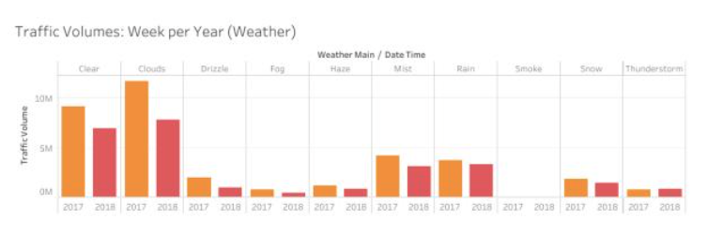
What role does weather play?
Clear/Cloudy doesn’t seem to provide enough detail for action
Snow vs. Rain is surprising but also shows our preparedness for snow
Precipitation shows the highest impact of other weather patterns
What can we do to help with rain?

Slide 6
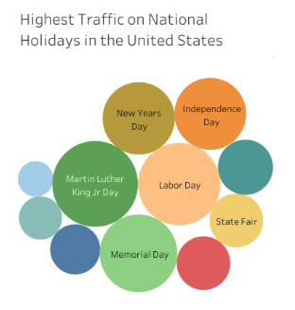
Holiday Travel
August - State fair starting in August
January - High traffic on New Years and Martin Luther King Jr. Day contribute to most of January’s total
Most holidays have little impact to traffic volumes

Slide 7
Thank You!

